Slide 1

A Dynamic Data Resilience Algorithm for Sensor Networks
Yeswanth Polu
Under the guidance of
Dr. Bin Tang
Notes:
Greeting to everyone watching my presentation. Hope everyone is doing good.
Before beginning the presentation I would like to thank Dr Bin tang whose has been an inspiration to me. He is the motivation for all the work that I did.
Slide 1:
Hello everyone My name is Yeswanth Polu, pursuing my Masters in Computer Science from California State University Dominguez hills.
This is a presentation about A DYNAMIC DATA RESILIENCE ALGORITHM FOR SENSOR NETWORKS.

Slide 2

abstract
Many of the sensor network applications are deployed in challenging environments, wherein sensors do not always have connected paths to a base station and propose a new data resilience problem. Such applications include underwater/deep sea sensor networks, seismic sensor networks, and volcano monitoring networks.
Existing research endeavors to maximize data resilience in such networks by offloading the overflow data from data nodes to initially high-energy storage nodes. We show that this approach does necessarily result in high data resilience level (DRL) that quantifies the data resilience performance. We propose a new algorithm that selects high-energy storage node dynamically. As the high energy storage nodes could change after each data offloading, choosing a best storage node in each iteration can help in achieving optimal data resilience. Using extensive simulations, we show that the dynamic data resilience algorithm outperforms the existing research in terms of achieved DRLs.
Notes:
Many of the sensor network applications are deployed in challenging environments, wherein sensors do not always have connected paths to a base station and propose a new data resilience problem. Such applications include underwater/deep sea sensor networks, seismic sensor networks, and volcano monitoring networks.
Existing research endeavors to maximize data resilience in such networks by offloading the overflow data from data nodes to initially high-energy storage nodes. We show that this approach does necessarily result in high data resilience level (DRL) that quantifies the data resilience performance. We propose a new algorithm that selects high-energy storage node dynamically. As the high energy storage nodes could change after each data offloading, choosing a best storage node in each iteration can help in achieving optimal data resilience. Using extensive simulations, we show that the dynamic data resilience algorithm outperforms the existing research in terms of achieved DRLs.

Slide 3
Background
Data Resilience refers to the ability of any network to recover quickly and to continue maintaining availability of data despite of disruptions
Disruptions can be equipment failure, power outage, or malicious attack.
Due to resource constraint challenges of wireless sensor networks such as replenishable battery power and limited storage capacity of sensor nodes, link unreliability and scarce bandwidth of wireless medium, and the inhospitable and harsh environments in which they are deployed sensor nodes are often prone to failure and vulnerable of data loss.
Notes:
•Data Resilience refers to the ability of any network to recover quickly and to continue maintaining availability of data despite of disruptions
•Disruptions can be equipment failure, power outage, or malicious attack.
•Due to resource constraint challenges of wireless sensor networks such as replenish-able battery power and limited storage capacity of sensor nodes, link unreliability and scarce bandwidth of wireless medium, and the inhospitable and harsh environments in which they are deployed sensor nodes are often prone to failure and vulnerable of data loss.

Slide 4
Data Resilience has been an active research since the inception of the sensor network research.
In this paper, we study data resilience from emerging sensor network applications wherein a base station is not available to collect the data.
Such applications include volcano and seismic sensor networks, underground sensor networks, underwater or ocean sensor networks, and volcano eruption monitoring and glacial melting monitoring.
Notes:
•Data Resilience has been an active research since the inception of the sensor network research.
•In this paper, we instead study data resilience from a totally different angle from emerging sensor network applications wherein a base station is not available to collect the data.
•Such applications include volcano and seismic sensor networks, underground sensor networks, underwater or ocean sensor networks, and volcano eruption monitoring and glacial melting monitoring.

Slide 5
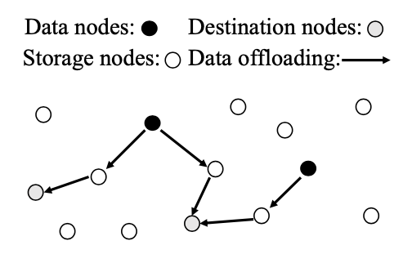
The network model
Notes:
This is the network model that we are going to discuss about. We can see that there are 3 types of nodes namely Data nodes, Storage nodes and Destination nodes. The arrow representing the process of offloading the data.
The data nodes are the nodes where the data is being generated. The storage nodes are the series of postman’s that are being used to deliver the data to the destination.
The destination nodes is where the data is stored for the resilience.

Slide 6
We model a sensor network as an undirected graph G(V,E) where V={1,2,3,…,n} are the nodes and E is the set of edges between the nodes.
The nodes are said to be connected if their distance is within the sensor nodes’ transmission range.
There are l data nodes denotes as V_{d} = {1,2,3..l}, these nodes consist of d_{i} number of the overflow data.
The rest of the n-l nodes are said to be storage nodes.
We assume the available storage space is greater than the overflow data; otherwise, the data loss is inevitable and data resilience is not achievable.
Notes:
•We model a sensor network as an undirected graph G(V,E) where V are the nodes and E is the set of edges between the nodes.
•The nodes are said to be connected if their distance is within the sensor nodes’ specified transmission range.
•There are l data nodes denotes as V_{d} = {1,2,3..l}, these nodes consist of the newly generated data or the overflow data.
•The rest of the n-l nodes are said to be storage nodes.
•We assume the available storage space is greater than the overflow data; otherwise, the data loss is inevitable and data resilience is not achievable.

Slide 7
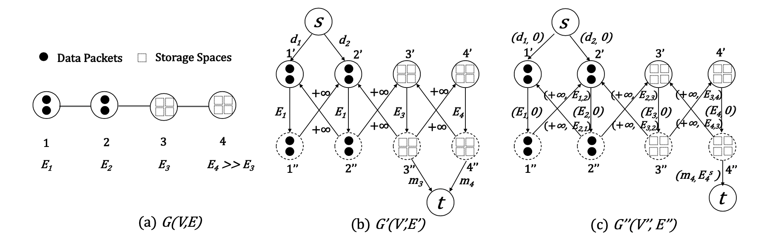
Graph conversion
To demonstrate the network flow techniques. we first convert the sensor network graph G(V , E ) to a flow network.
Notes:
To maximize the Data Resilience of any given instance the fundamental challenge is to find each data packet’s destination node as well as its offloading path from its data node to this destination node.
Then we are able to compute the number of data packets each destination node stores as well as its remaining energy level, therefore calculating the DRL.
In particular, we need to represent sensor energy levels, data packets offloaded, and storage capacities utilized such that they can be computed in a holistic manner
To demonstrate the network flow techniques. we first convert the sensor network graph G(V , E ) to a flow network.
Please follow the picture closely.
Picture (A) shows a linear sensor network G(V,E) with two data nodes 1 and 2, each having two data packets to offload, and two storage nodes 3 and 4, each having four storage spaces.
(b) shows its converted flow network G′(V ′, E′) that maximizes DRLs. Here S is the source and T is destinationHere we divide the undirected nodes into direct nodes consisting of in nodes and out nodes. i’ being the in node and I’’ being the out node.
(c) shows its converted flow network G′′(V′′,E′′) As E4 > E3 and node 4 has enough storage to store all the four data packets, the set of high-energy storage nodes Vh = {4}.

Slide 8
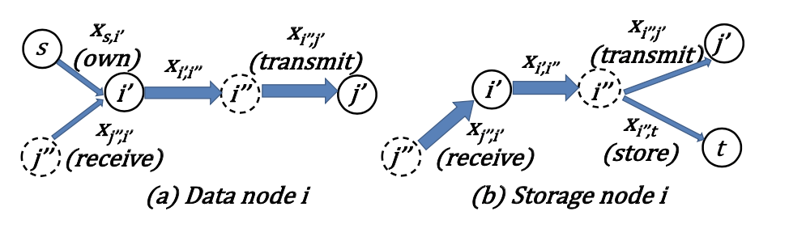
Data node “i” transmits its own data packets as well as the data packets received from other nodes, shown as two thin traffic converging to one thick traffic at i.
Storage node i transmits or stores the data packets received from others, shown as one thick traffic diverging into two thin traffic at i.
Notes:
•Data node “i” transmits its own data packets as well as the data packets received from other nodes, shown as two thin traffic converging to one thick traffic at i.
•Storage node i transmits or stores the data packets received from others, shown as one thick traffic diverging into two thin traffic at i.

Slide 9
Heuristic algorithm
To maximize DRLs, an intuitive solution is to offload data packets to nodes with high energy levels.
High Energy Storage nodes, are set of storage nodes with the highest initial energy levels that can storage all the “a” data packets.
For each high-energy storage node “i” ∈ V_{h}, Algorithm finds mi data packets that are closest to “i” and offloads them to “i” via the currently available shortest path. This takes place until all the “a” data packets are offloaded. Then finds the next high-energy storage
It takes O(n²).
Notes:
•To maximize DRLs, an intuitive solution is to offload data packets to nodes with high energy levels.
•High Energy Storage nodes, are set of storage nodes with the highest initial energy levels that can storage all the “a” data packets.
•For each high-energy storage node “i” ∈ V_{h}, Algorithm finds mi data packets that are closest to “i” (in terms of energy consumption) and offloads them to “i” via the currently available shortest path. This takes place until all the “a” data packets are offloaded.

Slide 10

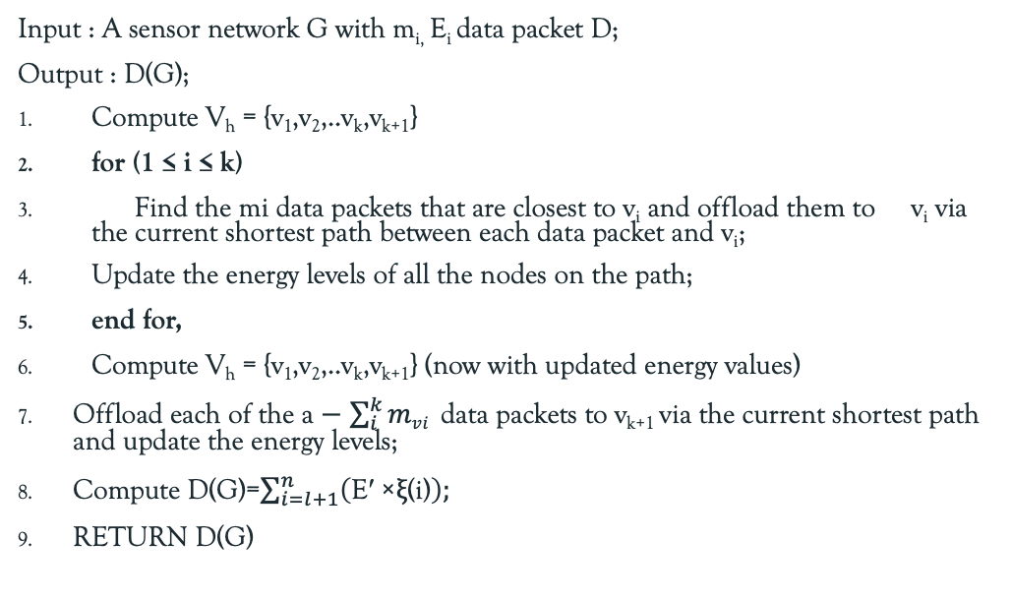
Algo: Node based algorithm
Input : A sensor network G with m_{i,} E_{i} data packet D;
Output : D(G);
Compute V_{h} = {v₁,v₂,..v_{k},v_{k+1}}
for (1 ≤ i ≤ k)
Find the mi data packets that are closest to v_{i} and offload them to v_{i} via the current shortest path between each data packet and v_{i};
Update the energy levels of all the nodes on the path;
end for,
Compute V_{h} = {v₁,v₂,..v_{k},v_{k+1}} (now with updated energy values)
Offload each of the a − $\sum_{i}^{k}{mvi}$ data packets to v_{k+1} via the current shortest path and update the energy levels;
Compute D(G)=$\sum_{i=l+1}^{n}{\left(\text{E}\text{′ ×}\text{ξ}\text{(}\text{i}\text{)}\right);}$
RETURN D(G)
Notes:
This is the pseudo algorithm for the node based algorithm.

Slide 11

Performance evaluation
Notes:
The most important part, the performance evaluation.

Slide 12
Comparisons
We compare the performance of the Node-based algorithm to the existing Network-based algorithm.
The simulator is written in java and takes as input the sensor the sensor network instance including the network topology, initial energy levels of each sensor nodes E_{i}, the data nodes and their overflow data packets di, the storage nodes and their storage capacities m_{j} , and generates various output files that conform to the format needed for CPLEX execution.
We consider both small scale networks of 50 sensor nodes (10 of them are data nodes) and large scale of 100 nodes (20 of them are data nodes).
Notes:
•We compare the performance of the Node-based algorithm to the existing Network-based algorithm.
•The simulator is written in java and takes as input the sensor the sensor network instance including the network topology, initial energy levels of each sensor nodes E_{i}, the data nodes and their overflow data packets di, the storage nodes and their storage capacities m_{j} , and generates various output files that conform to the format needed for CPLEX execution.
• We consider both small scale networks of 50 sensor nodes (10 of them are data nodes) and large scale of 100 nodes (20 of them are data nodes).

Slide 13
The sensor nodes are uniformly distributed in a region of 1000m × 1000m.
Each data node generates some number of overflow data packets, each of 512B, that to be offloaded into the network.
For initial energy levels, we consider both varying model, where different sensors have different initial energy levels, and uniform model, where all sensor nodes have the same initial energy levels.
Transmission range is 250m. In all plots, each data point is an average over ten runs, in each of which a different sensor network instance is generated.
For fair comparisons of algorithms, we used the same sensor network instance in the same run.
Notes:
•The sensor nodes are uniformly distributed in a region of 1000m × 1000m.
•Each data node generates some number of overflow data packets, each of 512B, that to be offloaded into the network.
•For initial energy levels, we consider both varying model, where different sensors have different initial energy levels, and uniform model, where all sensor nodes have the same initial energy levels.
•Transmission range is 250m. In all plots, each data point is an average over ten runs, in each of which a different sensor network instance is generated
For fair comparisons of different algorithms, however, we use the same sensor network instance in the same run. The error bars indicate 95% confidence intervals.

Slide 14
scenarios
Small-scale Comparison:
We compare a small scale of 50 nodes with 10 data nodes. The initial energy levels are random numbers in [2000μJ, 4000μJ ].
Large-scale Comparison:
We compare the algorithms in larger scale of 100 sensors, 20 of them are data nodes. The initial energy levels are random numbers in [2000μJ, 4000μJ ].
We determine the results in following criteria:
Data resilience problem: fix the storage node's storage and change the data item's amount.
Data resilience problem: change the storage node's storage and fix the data item's amount.
Notes:
•Small-scale Comparison:
•We compare a small scale of 50 nodes with 10 data nodes. The initial energy levels are random numbers in [2000μJ, 4000μJ ].
•Large-scale Comparison:
•We compare the algorithms in larger scale of 100 sensors, 20 of them are data nodes. The initial energy levels are random numbers in [2000μJ, 4000μJ ].
•We determine the results in following criteria:
1.Data resilience problem: fix the storage node's storage and change the data item's amount.
2.Data resilience problem: change the storage node's storage and fix the data item's amount.

Slide 15
Small Scale comparisons
Data resilience problem: fix the storage node's storage and change the data item's amount.
Notes:
Fig. varies data from the data node from 5, 10, 15, to 20 while setting storage data as 5. It shows that with the increase of data, the DRLs achieved by both the algorithms increase, as more data packets are now stored in storage node.
We can see that Node-based algorithm is optimal and both perform close at the saturation of the network, it demonstrates the efficacy of both algorithms in achieving data resilience. The second graph shows the total energy consumptions.

Slide 16
Small Scale comparisons
Data resilience problem: change the storage node's storage and fix the data item's amount.
Notes:
Fig. varies storage in the storage node from 5, 10, 15, to 20 while setting data from data node as as 10. It shows that with the increase of data, the DRLs achieved by both the algorithms increase, as more data packets are now stored in storage node.

Slide 17
Large Scale comparisons
Data resilience problem: fix the storage node's storage and change the data item's amount.
Notes:
Fig. varies data from the data node from 50, 75, 100, to 125 while setting storage data as 50. It shows that with the increase of data, the DRLs achieved by both the algorithms increase, as more data packets are now stored in storage node.
We can see that Node-based algorithm is optimal and significantly out performs network-based algorithm, it demonstrates the efficacy of both algorithms in achieving data resilience. The second graph shows the total energy consumptions.

Slide 18
Large Scale comparisons
Data resilience problem: change the storage node's storage and fix the data item's amount.
Notes:
Fig. varies data from the data node from 25, 50, 75, to 100 while setting data from the data node as 50. It shows that with the increase of data, the DRLs achieved by both the algorithms increase, as more data packets are now stored in storage node.
We can see that Node-based algorithm is optimal and significantly out performs network-based algorithm, it demonstrates the efficacy of both algorithms in achieving data resilience. The second graph shows the total energy consumptions.

Slide 19
Conclusion
We proposed a new algorithm to solve the data resilience problem that uniquely arises from emerging sensor network applications deployed in the extreme environment.
In some scenarios where the Network-based algorithm couldn’t perform the data resilience the Node-based algorithm could perform the resilience.
One limitation of our approach seems to be that the network scenario including the data nodes and their overflow data packets are known beforehand.
Notes:
•We proposed a new algorithm to solve the data resilience problem that uniquely arises from emerging sensor network applications deployed in the extreme environment.
•In some scenarios where the Network-based algorithm couldn’t perform the data resilience the Node-based algorithm could perform the resilience.
•One limitation of our approach seems to be that the network scenario including the data nodes and their overflow data packets are known beforehand.

Slide 20

Thank you Please, Do shoot your question

